Slide 1


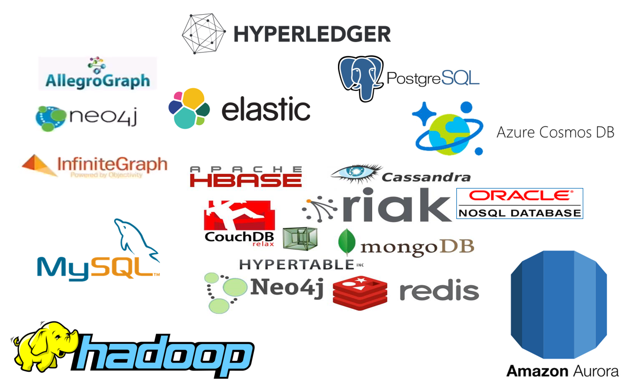


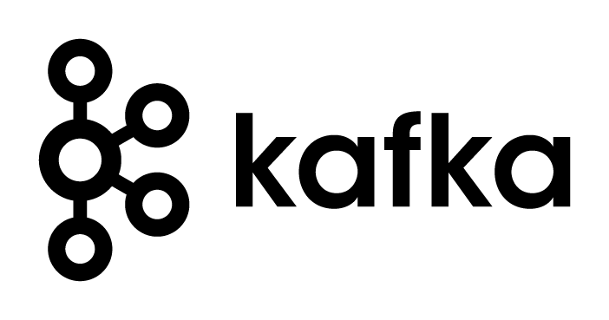


What is Apache Kafka & Why is it important to Oracle & Java & IT professionals?
The Event Fabric – bringing IT together
µ
µ
Lucas Jellema, CTO of AMIS
Oracle Groundbreakers APAC Tour
Perth, November 19th 2018
Notes:
What is Apache Kafka & why is it Important to Oracle professionals?
Events are playing an increasingly important role in modern application architecture. They represent fast, streaming data, they fuel the interaction between microservices, they are at the core of CQRS and event sourcing. Apache Kafka has quickly emerged as the de facto standard event platform: open source, cross technology, reliable and extremely scalable and available on any platform, in Docker and from the major cloud platforms- including Oracle Cloud’s Event Hub service. This session explains the what, why and how of Apache Kafka. What role does it play, how is it used and what are challenges and tricks for real life applications. How does it fit in with Oracle Database and Fusion Middleware and with Oracle Public Cloud? In several demos, Kafka is seen at work - in real time streaming event analysis through KSQL, in CQRS and microservices scenarios and with user interfaces updated in real time through events and HTML5 server sent events.
This presentation includes a demonstration of remote database synchronization through Twitter.

Slide 2
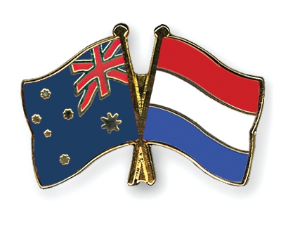

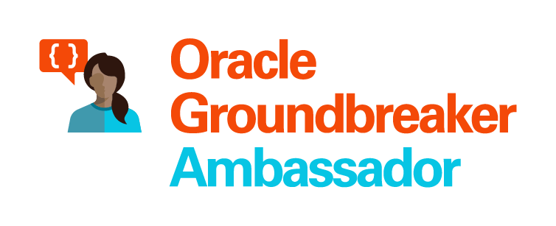


Lucas Jellema Architect / Developer 1994 started in IT at Oracle 2002 joined AMIS Currently CTO & Solution Architect

Slide 3
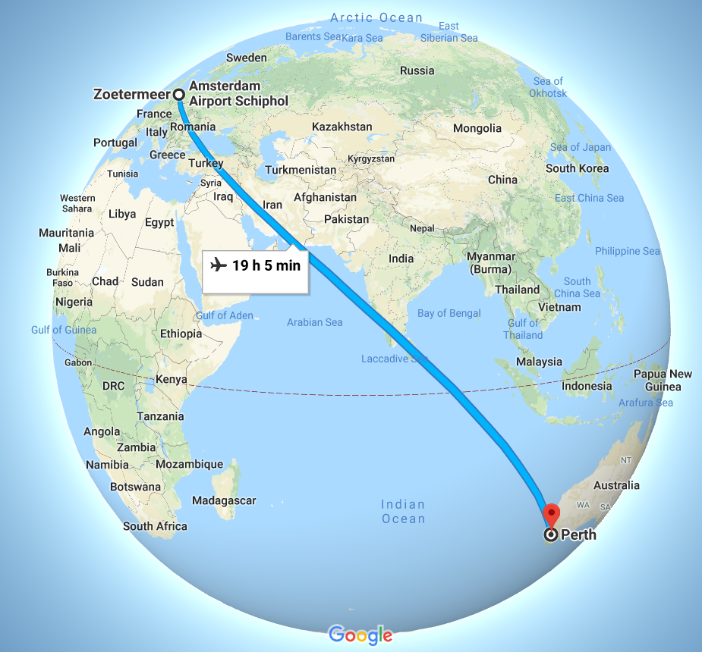
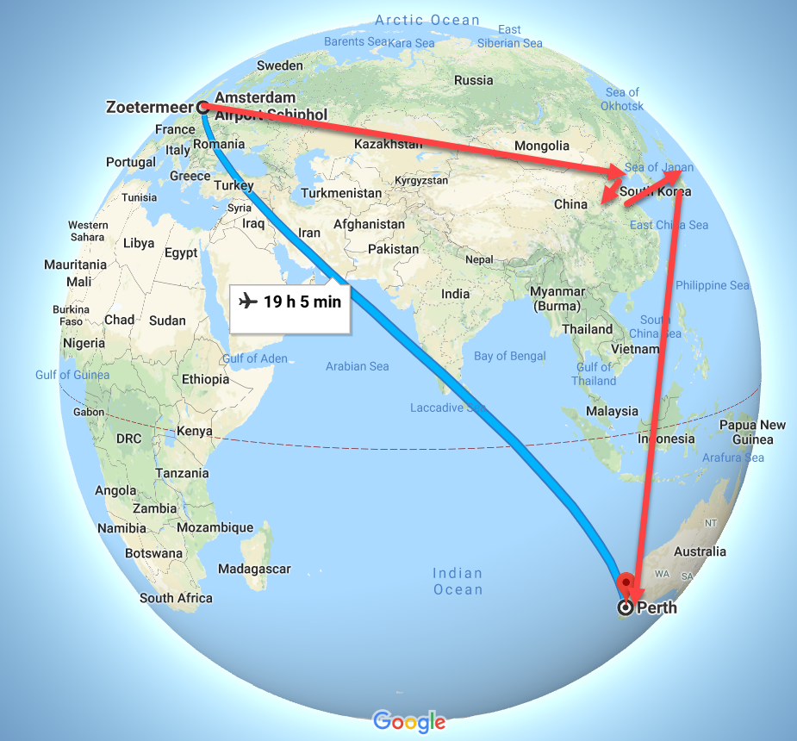
Tour of Asia & Pacific

Slide 4


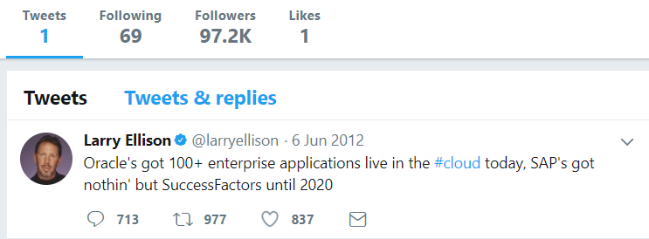
Heck, I do not even know these people and they may not know me [personally] – just my pearls of wisdom. And if they are late to the party, they can also check out the historic archives of my eloquence
Without fretting about the numbers of readers involved and whether they are in the same time zone as me and online when I publish my messages – and which device they use
It would be so nice if I could publish my ideas and actions, accessible near instantly for everyone who is interested

Slide 5
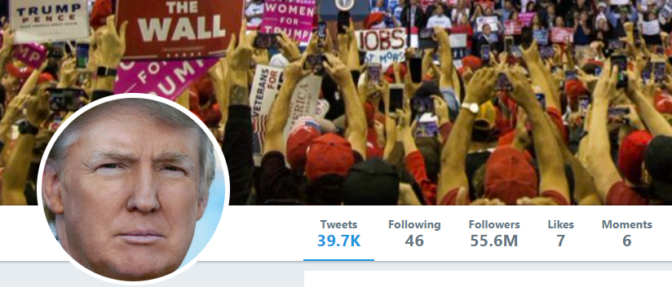
Heck, I do not even know these people and they may not know me [personally] – just my pearls of wisdom. And if they are late to the party, they can also check out the historic archives of my eloquence
Without fretting about the numbers of readers involved and whether they are in the same time zone as me and online when I publish my messages – and which device they use
It would be so nice if I could publish my ideas and actions, accessible near instantly for everyone who is interested

Slide 6

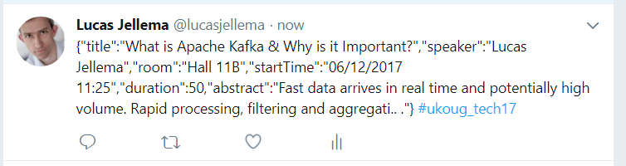
Decoupled communication
0, 1 or many followers
Scalable number of messages (and parties)
Reliable (mostly available, few messages lost)
Full history
Open: cross device, cross location
Not Sub-second, near real-time fast
Rate limited (#messages/minute)
Size limited (140-280 characters)
Format limited (text)
Not for private interactions
Not (really) for programmatic use

Slide 7



MongoDB
ORDERS
Oracle Database
DVX_ORDERS

Slide 8
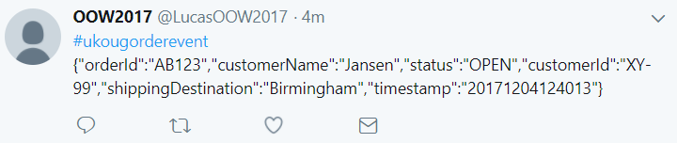
MongoDB
ORDERS
8
DML
Oracle Database
DVX_ORDERS

Slide 9


MongoDB
µ
ORDERS
Oracle Application Container Cloud
9
DML
Oracle Database
Node application running on Oracle Kubernetes Engine
µ
DVX_ORDERS

Slide 10
What does the Twitter for System Driven Event Interaction look like?
Decoupled communication – organized per topic
0, 1 or many Consumers per Topic
Scalable number of messages (and parties)
Reliable (distributed)
Full history
Open: libraries in many technologie & REST APIs

Slide 11
MongoDB
µ
ORDERS
Oracle Application Container Cloud
Oracle Event Hub
DML
Oracle Database
Node application running on Oracle Kubernetes Engine
µ
DVX_ORDERS

Slide 12
What does the Twitter for System Driven Event Interaction look like?
Decoupled communication – organized per topic
0, 1 or many Consumers per Topic
Scalable number of messages (and parties)
Reliable (distributed)
Full history
Open: libraries in many technologie & REST APIs
Near real-time fast
No Rate Limit
No enforced size limit
Anything goes (it’s all byte[])
On premises or in cloud, private or trusted
Very much for programmatic use

Slide 13
Products
Data Manipulation
Data Retrieval

Slide 14
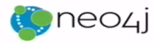



CQRS = Command Query Responsibility Segregation
Products
Data Manipulation
Quick Product Search Index
Special Products
Data Retrieval
Toys
Product Clusters
Product Store in SaaS app
Food Stuff
Notes:
Data manipulation and retrieval in separate places
(physical data proliferation)
Query store is optimized for consumers
Level of detail, format, filters applied
For performance and scalability, independence, productivity lower license fees and lower TCO, security

Slide 15

Comand Query Responsbility Segregation = CQRS
Detect changes
Products
Extract Data
Data Manipulation
Special Products
Data Retrieval
Toys
Quick Product Search Index
Product Clusters
Food Stuff
Product Store in SaaS app
Notes:
No Event Sourcing
No events (?)
No green field
Packages Applications/SaaS
Databases (RDBMS, NoSQL) getting changes from applications directly
Challenges – at scale, with enough speed and consistently: do not let query store get into an exposed state that could not exist/be right!
Detect relevant changes
Extract relevant changes
Transport
Convert
Apply in correct order and reliably (no lost events)
Note: after detect and extract, an event can be published

Slide 16
Events
Consumers
Producers
Robust, Scalable, Fast, History Retention
Containerized/Cloud-enabled
Open

Slide 17
Messaging as we know it
JMS, Oracle Advanced Queuing, IBM MQ, MS MQ, RabbitMQ, MQTT, XMPP, WebSockets, Apache Active MQ, AMQP , …
Challenges
Costs
Scalability (size and speed)
(lack of) Distribution (and therefore availability)
Complexity of infrastructure
Message delivery guarantees
Lack of technology openness
Deal with temporarily offline consumers
Retain history

Slide 18

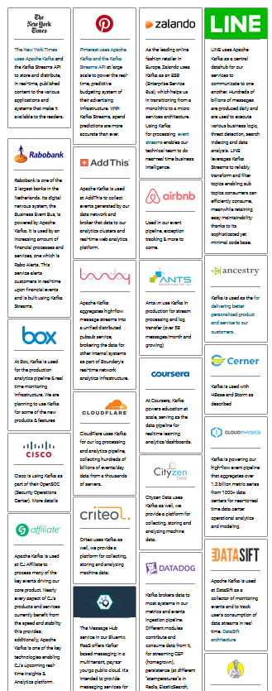

Introducing Apache Kafka
..- 2010 – creation at Linkedin
Message Bus | Event Broker
High volume, low latency, highly reliable, cross technology
Scalable, distributed, strict message ordering, ….
2011/2012 – open source under the Apache Incubator/ Top Project
Kafka is used by many large corporations:
Walmart, Cisco, Netflix, PayPal, LinkedIn, eBay, Spotify, Uber, Sift Science, Zalando, The New York Times, Airbnb, Coursera, ING Bank,…
And embraced by many software vendors & cloud providers
Client libraries available for Node, Java, C/C++, Python, Ruby, PHP, Go, Rust, .NET, Perl, Scala DSL, Clojure, Swift and more
Commercial backing by and Enterprise support from Confluent

Slide 19
Consumers
tcp
Producers
tcp

Slide 20
Consumers
Producers
Topic

Slide 21
Kafka terminology
Topic
Message
== ByteArray
Broker
Producer
Consumer
Message
Key
Value
Time
Producer
Consumer
Broker
Topic

Slide 22
Key
Value
Time
Consumers
Producers
Broker
Topic

Slide 23
Consuming
Messages are available to consumers only when they have been committed
Kafka does not push
Unlike JMS
Read does not destroy
Unlike JMS Topic
(some) History available
Offline consumers can catch up
Consumers can re-consume from the past
Delivery Guarantees
Ordering maintained
At-least-once (per consumer) by default; at-most-once and exactly-once can be implemented

Slide 24
Key
Value
Time
Consumers
Producers
Broker
Topic

Slide 25
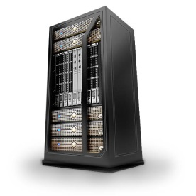

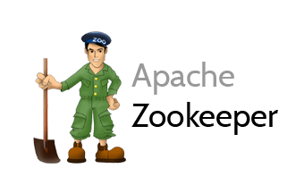
Consumers
tcp
Producers
tcp
Broker
Topic
Partition
Consumer Group

Slide 26
What’s so special?
Durable
Scalable
High volume
High speed
Available
Distributed
Open
Quick start
Free (no license costs)
“Self Fulfilling Prophecy” (positive feedback loop feeding from buzz around Kafka)
Eco system, tools/libraries/resources, cloud services

Slide 27
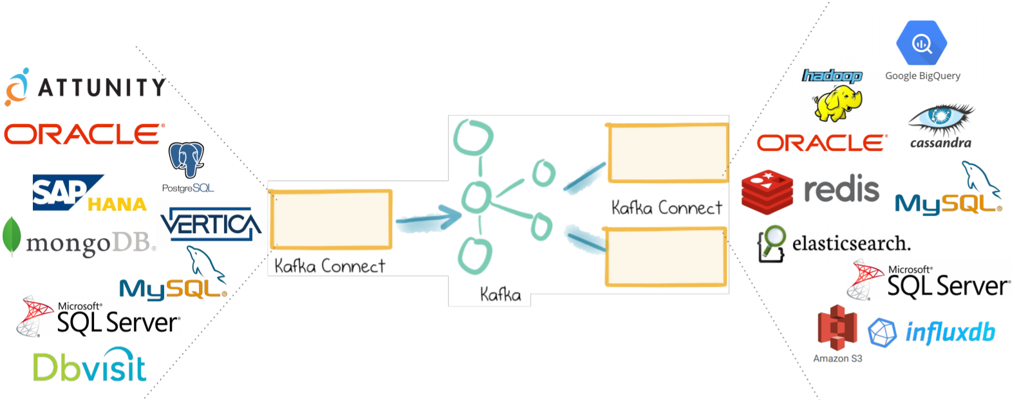
Ecosystem – Kafka and Friends
Clients
CLI
Java, Node/JavaScript, C/C++, Python, Go, Rust, .NET, Ruby, Clojure, Perl, …
REST Proxy
Kafka Schema Registry
Kafka Connect – read data and change events from many sources and/or write to many targets
Also see Debezium
Kafka Streams
Kafka KSQL

Slide 28

Tweet! #codeone

Slide 29
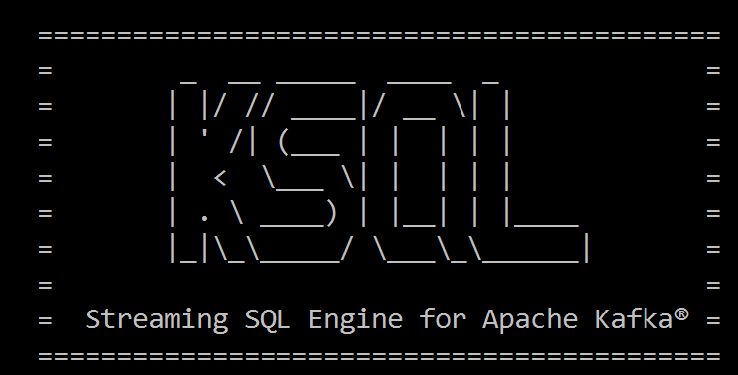
Select from <stream of tweet events>
select text , author , timestamp
from tweets
Where tag = 'codeone'
<--- streaming data

Slide 30
Select Running Count from <stream of tweet events>
select tag
, count(*) tweet_count from tweets
group by tag

Slide 31
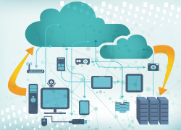
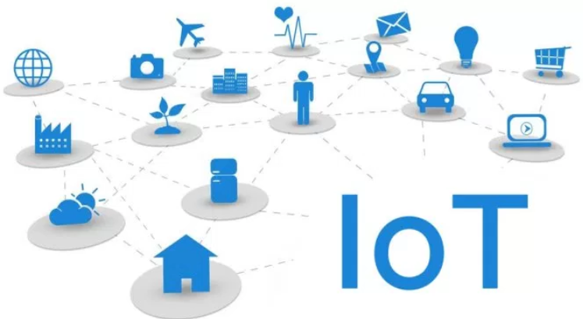

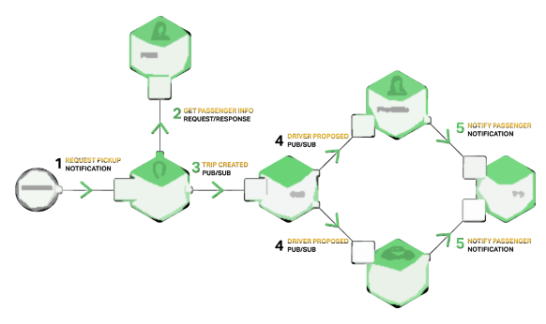






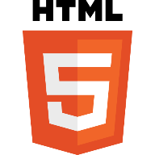




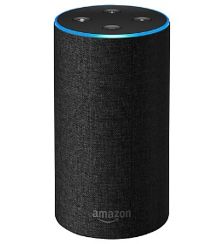
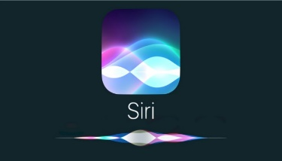

Oracle Cloud
Tweets on #CodeOne #java #oraclecode
IoT metrics from hundreds of devices
User actions & click events from webshop
Live Traffic Events
Microservices chatter
Social Media events (Facebook, Whatsapp, …)
IT Operations – monitoring metrics
Application Container
Event Hub
Tweets
Topic
Client
Client
Client
Client
Running Tweets Aggregation
SSE
µ
TWEET_COUNT Topic
µ
µ
µ

Slide 32

Final Demo
Microservices
Microservice

Slide 33
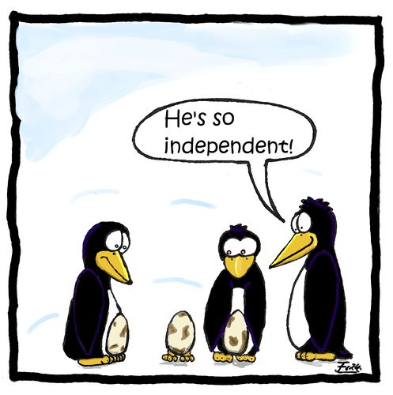
Microservices
Agile | Flexible | Scalable | (Re)Deployable
Independent | Decoupled | Isolated
Communicate asynchronously, via events
Have their own private bounded context – the data they require to function
Their lifeblood

Slide 34
The Microservice
HTTP REST/JSON
API

Slide 35
Extended API of microservice
API
Deployment API
Injectable dependencies – reference to cache, logging, storage URL, …
Configurable meta-data – run time parameters, log level, credential (key)
Interaction API
REST Resources & Operations – query and URL parameters, message formats
Events Consumed – alternative way to call | activate a microservice
Reference to entry in Event Catalog
May include reference to shared Cache Resource
Events Produced – alternative output from microservice
Event can be an asynchronous response to a stateless consumer

Slide 36
Microservices State
Generic Platform for running microservices
LDAP
Big Data
Block Storage
Cache
RDBMS
NoSQL
Document Store
Event Hub
Notes:
All data stores are distributed
Or at least distributedly available
They can be local or on cloud (latency is important)
Data in generic data store is still owned by only one microservice – no one can touch it
Only in DWH and BigData do we deliberately take copies of data and disown them

Slide 37
Bounded context of microservices
A micoservice needs to be able to run independently
It needs to contain & own all data required to run
It cannot depend on other microservices
UI
API
Customer
API
Order
CustomerModified event

Slide 38




Demo – Maintaining Derived Data in Bounded Context using Data Change Events communicated cross cloud over Kafka
Customer Microservice
Order Microservice
Customer Modified Event
Application Container
Application Container
Event Hub
Customers
Topic
DBaaS

Slide 39
Use cases for events
Data Synchronization, (near real-time) replication, CQRS
Event Sourcing
Microservices
Decoupled interaction
Workflow & collaboration
Bounded Context synchronization
Serverless Functions
Fast and Streaming Data – for example from IoT
(near) Real Time User Interfaces
with SSE WebSocket based push to browser or mobile push notifications
…

Slide 40

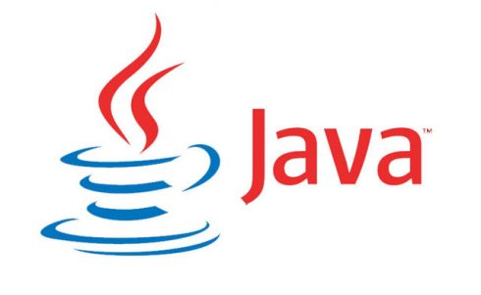
Getting Started with Apache Kafka
Get Access to an Apache Kafka Cluster environment
Download, Install, Configure and Run
Pull and Run a Docker Container (optionally on a Kubernetes cluster)
Sign up for a Managed Apache Kafka Cloud Service (e.g. Oracle Event Hub)
Configure Topic(s) & Partition(s) (optional)
Get an Apache Kafka Client Library
For Java, Spring Boot, Node, Python, …
Or expose Apache Kafka REST Proxy service
Develop Client Application to
Produce Events to Kafka Topic
Consume Events from Kafka Topic
Optionally
Use Schema Registry to design, publish and enforce event payload structure
Use Kafka Connect[ors] to integrate with specific source or sink technology
Use tooling for monitoring, tuning, reporting, administration, …
Topic

Slide 41
Develop Client Applications
Leveraging a precreated Event Hub Managed Kafka Topic in the cloud
Simple Node client
To publish message to Apache Kafka
using kafka-node npm module
Simple Java client
To consume messages from Apache Kafka
using org.apache.kafka.kafka_2.12 Maven dependency
Topic

Slide 42
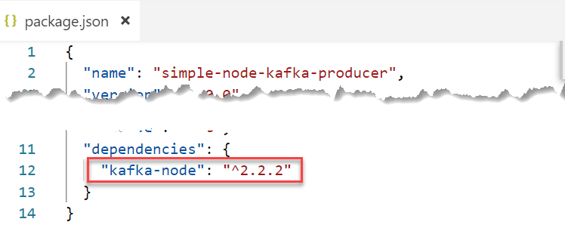
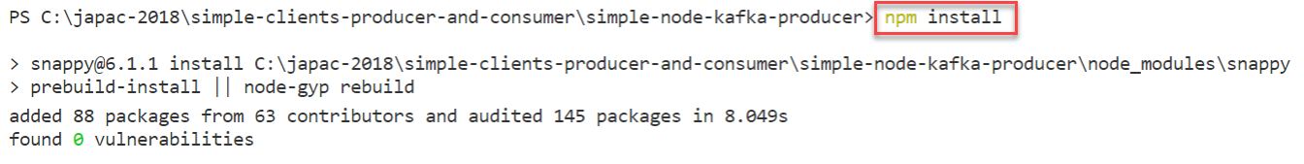
Kafka Node Client Producer
package.json
npm install

Slide 43
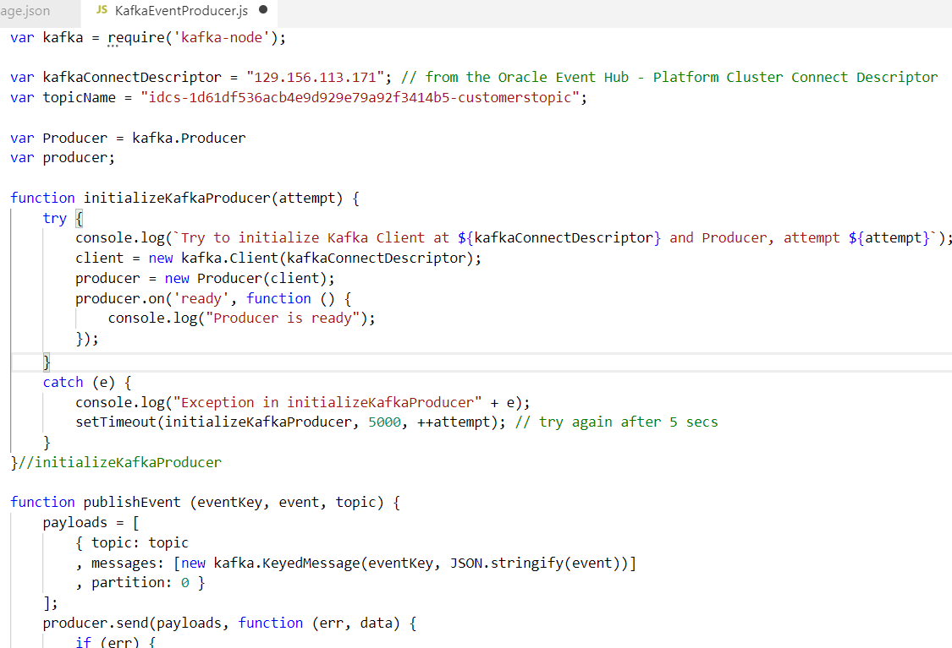
Kafka Node Client (2)

Slide 44
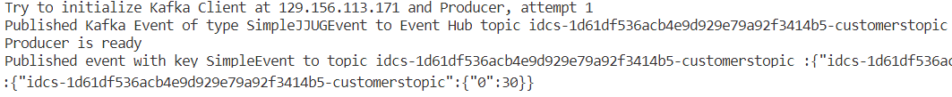
Kafka Node Client (3)
Run

Slide 45
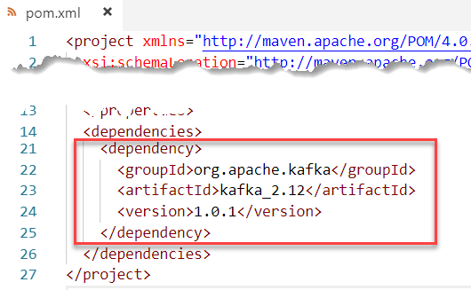
Kafka Java Client - Consumer
mvn init
pom.xml

Slide 46
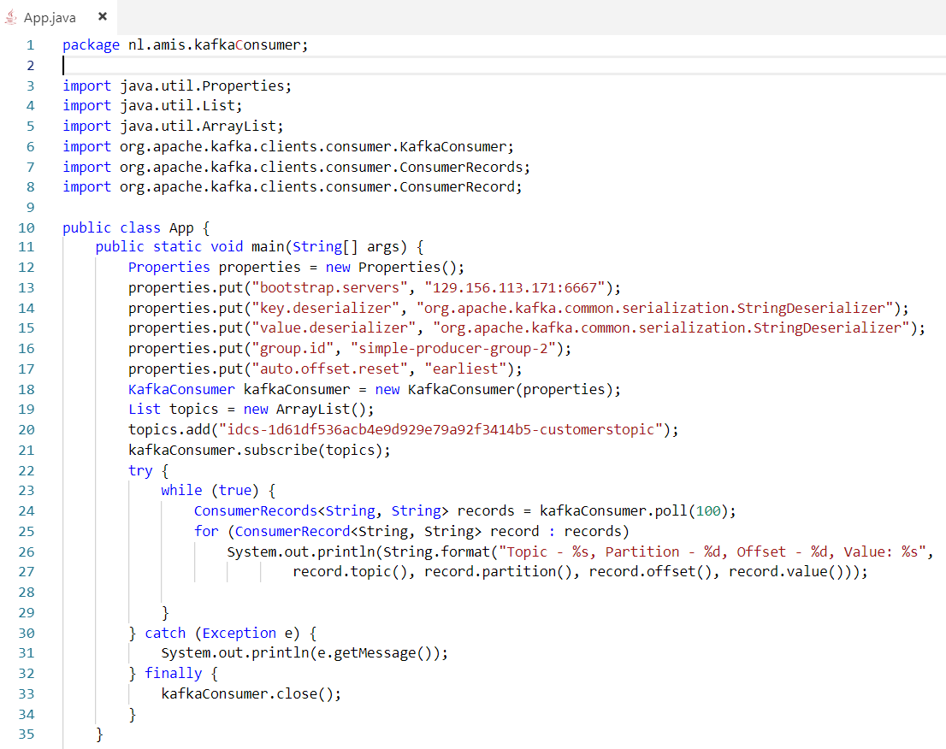
Kafka Java Client - Consumer

Slide 47
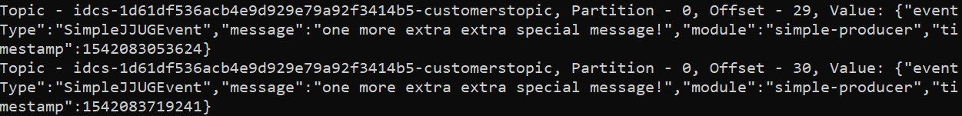
Kafka Java Client – Consumer (3)
Run

Slide 48
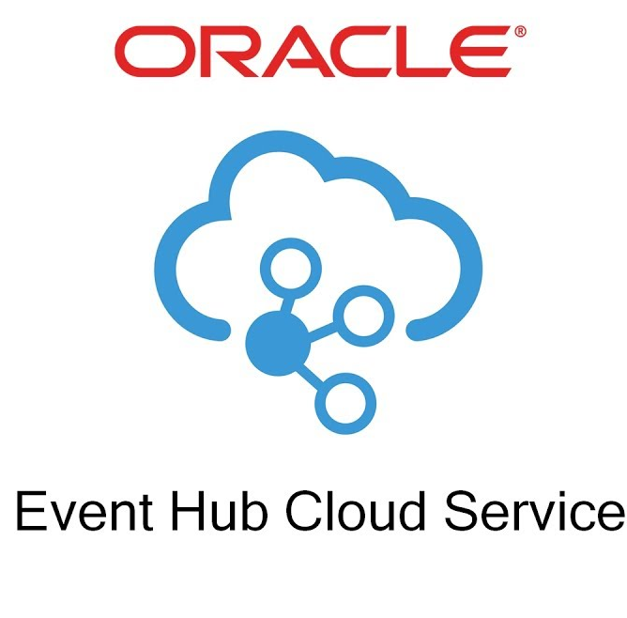
Oracle embracing Apache Kafka
Event Hub Cloud Service = Managed Apache Kafka platform
Managed Topics have been announced too
Oracle Cloud Infrastructure: Telemetry & Streaming
Read from Kafka Topic in Oracle Database SQL queries
And publish to Kafka Topic from Oracle Database PL/SQL

Slide 49

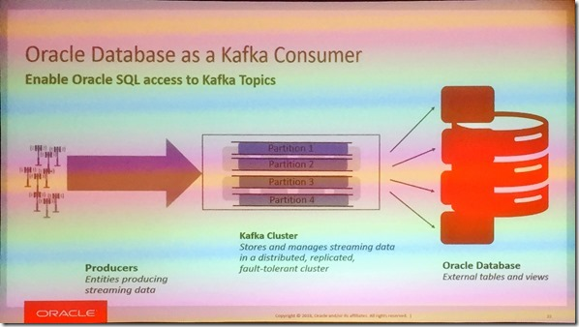
SQL on Kafka in Oracle Database
Oracle Database works with Kafka Topics as “external table”
Publishing from Oracle Database to a Kafka Topic is on the roadmap for v2
Announced at OOW 2018, planned for Spring 2019

Slide 50
Oracle embracing Apache Kafka
Event Hub Cloud Service = Managed Apache Kafka platform
Managed Topics have been announced too
Oracle Cloud Infrastructure: Telemetry & Streaming
Read from Kafka Topic in Oracle Database SQL queries
And publish to Kafka Topic from Oracle Database PL/SQL
Kafka as source for Data Integration Platform (Golden Gate and ODI)
Data Pipeline with Data Hub (Apache Cassandra) & Event Hub
Oracle Service Bus Kafka Adapter
Integration Cloud
Stream Analytics (aka Stream Explorer fka Oracle Event Processor)
Oracle Native Container and Microservices Platform
Fn Serverless Platform – triggered by and publishing to
Visual Builder & JET - real time push based on Apache Kafka
In general – the bridge between on premises ⬄ [public] Cloud

Slide 51

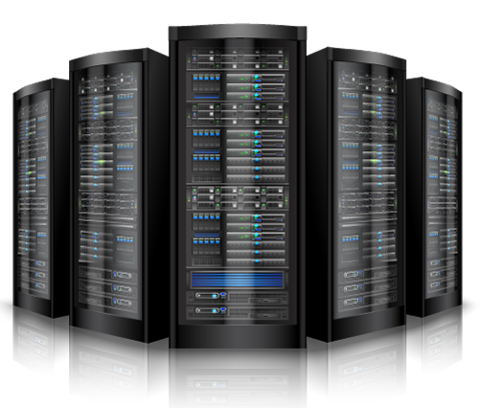
Summary
=> == =>
Apache Kafka is emerging as platform of choice for message exchange in a world of
Microservices
CQRS and Data Source Synchronization
Clouds
Fast Data (IoT) and Streaming Analysis
Real time data integration & distribution
Oracle is rapidly embracing Apache Kafka on various levels
Getting started with Apache Kafka is not very hard at all
The platform is open source – and has broad client support (Java, Node, …)
Many resources are available – tutorials, blog article, demonstrations, presentation slides and recordings of conference sessions, samples on GitHub

Slide 52




Thank you! ありがとうございました
Blog: technology.amis.nl
Email: lucas.jellema@amis.nl
: @lucasjellema
: lucas-jellema
: www.amis.nl, info@amis.nl
Notes:
Arigato-gozaimasta
Arigatōgozaimashita

